Slide 1
Thermosetting polymers

Slide 2
Thermosetting polymers
A thermosetting plastic, or thermoset, solidifies or "sets" irreversibly when heated. Thermosets cannot be reshaped by heating.
2. thermosets do not melt upon heating but begin to decompose
3. they cannot easily be reprocessed after the cross linking reaction has
occurred and hence recycling is difficult
4. In general thermosets have high thermal stability, three- dimensional networked polymers in which there is ahigh degree of cross-linking between polymer chains.
5. Therefore hard and rigid at room temperature and not soften on heating. The cross-linking restricts the motion of the chains and leads to a rigid material.
Thermosets are strong and durable. They primarily are used in automobiles and construction. They also are used to make toys, varnishes, boat hulls, and glues.

Slide 3
Thermosetting polymers
- stability, high stiffness, good resistance to creep, low densities, high electrical and thermal insulating properties
- Thermosetting resins are used in molded and coated plastics. They are first polymerized into a low-molecular-weight linear or slightly branched polymer or oligomer, which is still soluble, fusible, and highly reactive during final processing.
Thermoset resins are generally highly filled with mineral fillers and glass fibers.
Thermosets are generally catalyzed and/or heated to finish the polymerization
reaction, cross-linking them to almost infinite molecular weight. This step is often referred to as cure. Such cured polymers cannot be reprocessed or reshaped.
The high filler loading and the high cross-link density of thermoset resins results in very high densities and very low ductility, but very high rigidity and good chemical resistance.

Slide 4
Types of thermosetting polymers
Phenolic Resins
Phenolic resins combine the high reactivity of phenol and formaldehyde to form polymers and oligomers called resoles and novolacs. These materials are combined with fibrous fillers to give a phenolic resin, which when heated provides rapid, complete cross-linking into highly cured structures. The high crosslinked aromatic structure has high hardness, rigidity, strength, heat resistance good electrical properties. resistance, and broad chemical resistance
Uses. Phenolic applications include automotive uses (distributor caps, rotors, brake linings), appliance parts (pot handlesمقابض الاواني , knobs, bases, electrical /electronic components (connectors, circuit breakers, switches), and as an adhesive in laminated materials (e.g., plywood).

Slide 5
Epoxy Resins
The most common epoxy resins are prepared from the reaction of bisphenol A and epichlorohydrin to yield low-molecular-weight resins that are liquid either at room temperature or on warming. Each polymer chain usually contains two or more epoxide groups. The high reactivity of the epoxide groups with amines, anhydrides, and other curing agents provides facile conversionتحول سهل into highly crosslinked materials. Cured epoxy resins exhibit hardness, strength,heat
Uses. Epoxy resins are used in glass reinforced, high-strength composites in aerospace, pipes, tanks, pressure vessels; encapsulation or casting of various electrical and electronic components (printed wiring boards, etc.); adhesives; protective coatings in appliances, flooring, and industrial equipment; and sealants

Slide 6
Unsaturated Polyesters
Unsaturated polyesters are prepared by the condensation polymerization of various diols and maleic anhydride to give a very viscous liquid that is dissolved in styrene monomer. The addition of styrene lowers the viscosity to a level suitable for impregnationالتطعيم and laminationعملية صنع الرقائق الزجاجية of glass fibers. The low-molecular weight polyester has numerous (many) (fumarate ester units) that provide easy reactivity with styrene monomer. Properly formulated glass-reinforced unsaturated polyesters are commonly referred to as sheet molding compound (SMC) or (sheet moulding composite is a ready to mould glass-fibre reinforced polyester material primarily used in compression moulding), or reinforced plastics. In combination with reinforcing materials such as glass fiber, cured resins offer outstanding strength, high rigidity, impact resistance, high strength-to-weight ratio, and chemical resistance. SMC typically is formulated with 50% calcium carbonate filler, 25% long glass fiber, and 25% unsaturated polyester. The highly filled nature of SMC results in high density and brittle easily pitted surface.
Bulk molding compound (BMC) is formulated similar to SMC except -in. chopped glass is used. The shorter glass length gives easier process but lower strength and
Uses. The prime(major) use of unsaturated polyesters is in combination with glass fibers in high-strength composites and in SMC(Sheet Molding Compounds) and BMC(Bulk Molding Compounds) materials.

Slide 7
The applications
include transportation markets (large body parts for automobiles, trucks, trailers,
buses, and aircraft) المقطورات والحافلات والطائرات, marine markets (small- to medium-sized boat hulls and associated marine equipment), building panels, housing and bathroom components

Slide 8
Amino Resins
The two main members of the amino family of thermosets are the melamine and urea resins. They are prepared from the reaction of melamine and urea with formaldehyde. In general, these materials exhibit extreme hardness, scratch resistance, electrical resistance, and chemical resistance.
Uses. Melamine resins find use in colorful, rugged dinnerware, decorative laminates (countertops, tabletops, and furniture surfacing), electrical applications (switchboard panels, circuit breaker parts, arc barriers, and armature and slot wedges), and adhesives and coatings.
Urea resins are used in particleboard binders, decorative housings, closures, elecrical parts, coatings, and paper and textile treatment.

Slide 9
Alkyd Resins
Alkyd resins are based on branched polymers from glycerol, phthalic anhydride, and glyceryl esters of fatty acids(إسترات الجليسريل للأحماض الدهنية). Alkyds have excellent heat resistance, are dimensionally stable at high temperatures, and have excellent dielectric strength (_14 MV/m), high resistance to electrical leakage, and excellent arc resistance.
Uses. Alkyd resin applications include drying oils in enamel paints(زيوت التجفيف في دهانات المينا), lacquers for automobiles and applications; and molding compounds when formulated with reinforcing fillers for electrical applications (circuit breaker insulation, encapsulation of capacitors and resistors, and coil forms).

Slide 10
Diallyl Phthalate
Diallyl phthalate (DAP) is the most widely used compound in the allylic family. The neat(well-ordered ) resin is a medium-viscosity liquid. These low-molecular-weight polymers can be reinforced and compression molded into highly cross-linked, completely cured products.
The most outstanding properties of DAP are excellent dimensional stability and high insulation resistance. In addition, DAP has high dielectric strength, excellent arc resistance, and chemical resistance.
Uses. DAP applications include electronic parts, electrical connectors, bases and housings. DAP is also used as a coating and impregnating material.

Slide 11

Material | E, GPa | UTS, MPa | K, MNm^{-3/2}
PVE | 1.5 to 4 | 40 to 80 | 1 to 3
POLYESTER | 1-4 | 30-70 | 0.5
Epoxy | 2-5 | 40-80 | 1
PEEK | 3.6 | 90 to 170 | 7.5
PEI | 3.3 | 93 to 197 | 10
Note: (UTS ) is Ultimate tensile strength
مقاومة شد عالية جدا

Slide 12

Formica is a brand of composite materials which are heat-resistant, wipe-clean, plastic laminate with melamine resin.
If exposed to enough heat, melamine will decompose. For this reason, melamine dishware should not be exposed to high temperatures like those in the oven and microwave.

Slide 13

1.Toxicity, None
  Extinguishing, Self اطفاء ذاتي
  Halogen Content, None
  Electrically Insulating
  Hardness, High
  Brightness, High
  Scratch Resistant
  Copolymer
  Strength, High

Slide 14

Uses for melamine include floor tilesبلاطات الارضيات , kitchenware, fire retardant fabricsمواد مثبطة للحرائق , and commercial filtersفلاتر تقليدية .
Melamine is an organic compound that is often combined with formaldehyde to produce melamine, a synthetic polymer which is fire resistant and heat tolerant.
melamine releases water.

Slide 15
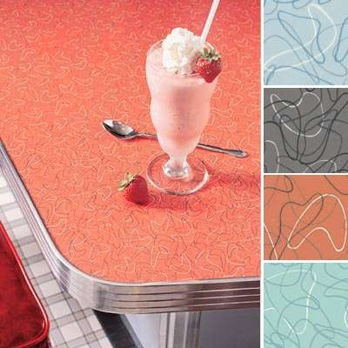
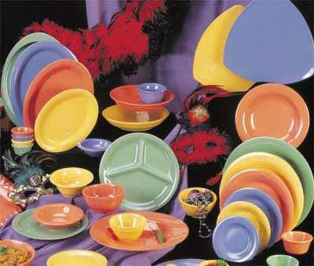

Slide 16
